Slide 1


Byzantine Resilience in Federated Learning
A Novel Two-Stage Aggregation Protocol (AEGIS)
Name - Abhishek Kumar Tripathi
Entry No - 2024EET2845
Guide – Prof Harshan Jagdeesh

Slide 2
Contents
FL Basics
1.
Problem Statement
2.
Prposed ‘AEGIS’
3.
Project Setup
4.
Experiment Outcome
5.
Future Scope
6.

Slide 3
WHAT IS FL

Slide 4
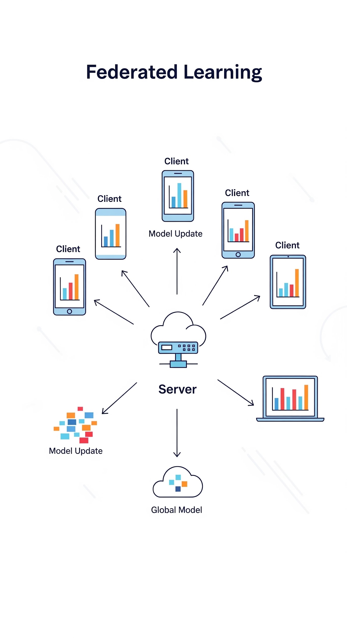
What is Federated Learning?
A decentralized machine learning paradigm.
Clients train a model locally on their private data.
Only model updates (weights) are sent to a server, never the raw data.
The server aggregates these updates to create an improved global model, which is sent back to the clients.
This process repeats iteratively.
It preserves data privacy, but creates new, significant security risks.

Slide 5
PROBLEM STATEMENT

Slide 6
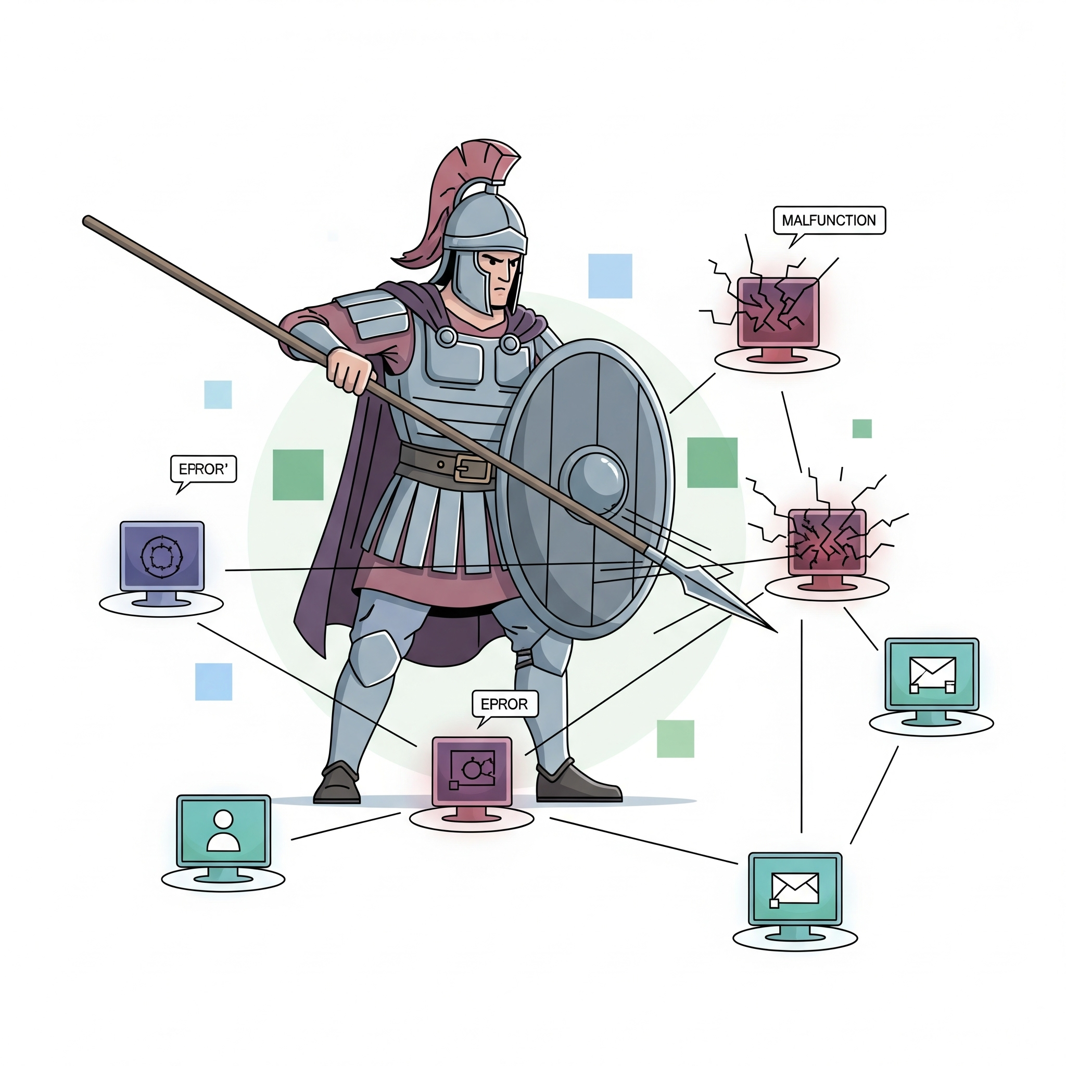
Problem Statement
Attackers, or malicious clients, compromise the global model by submitting "poisoned" updates to the server. Our experiment specifically investigates the impact of two types of attacks designed to corrupt or stall the model: sign-flip and additive-noise attacks.

Slide 7
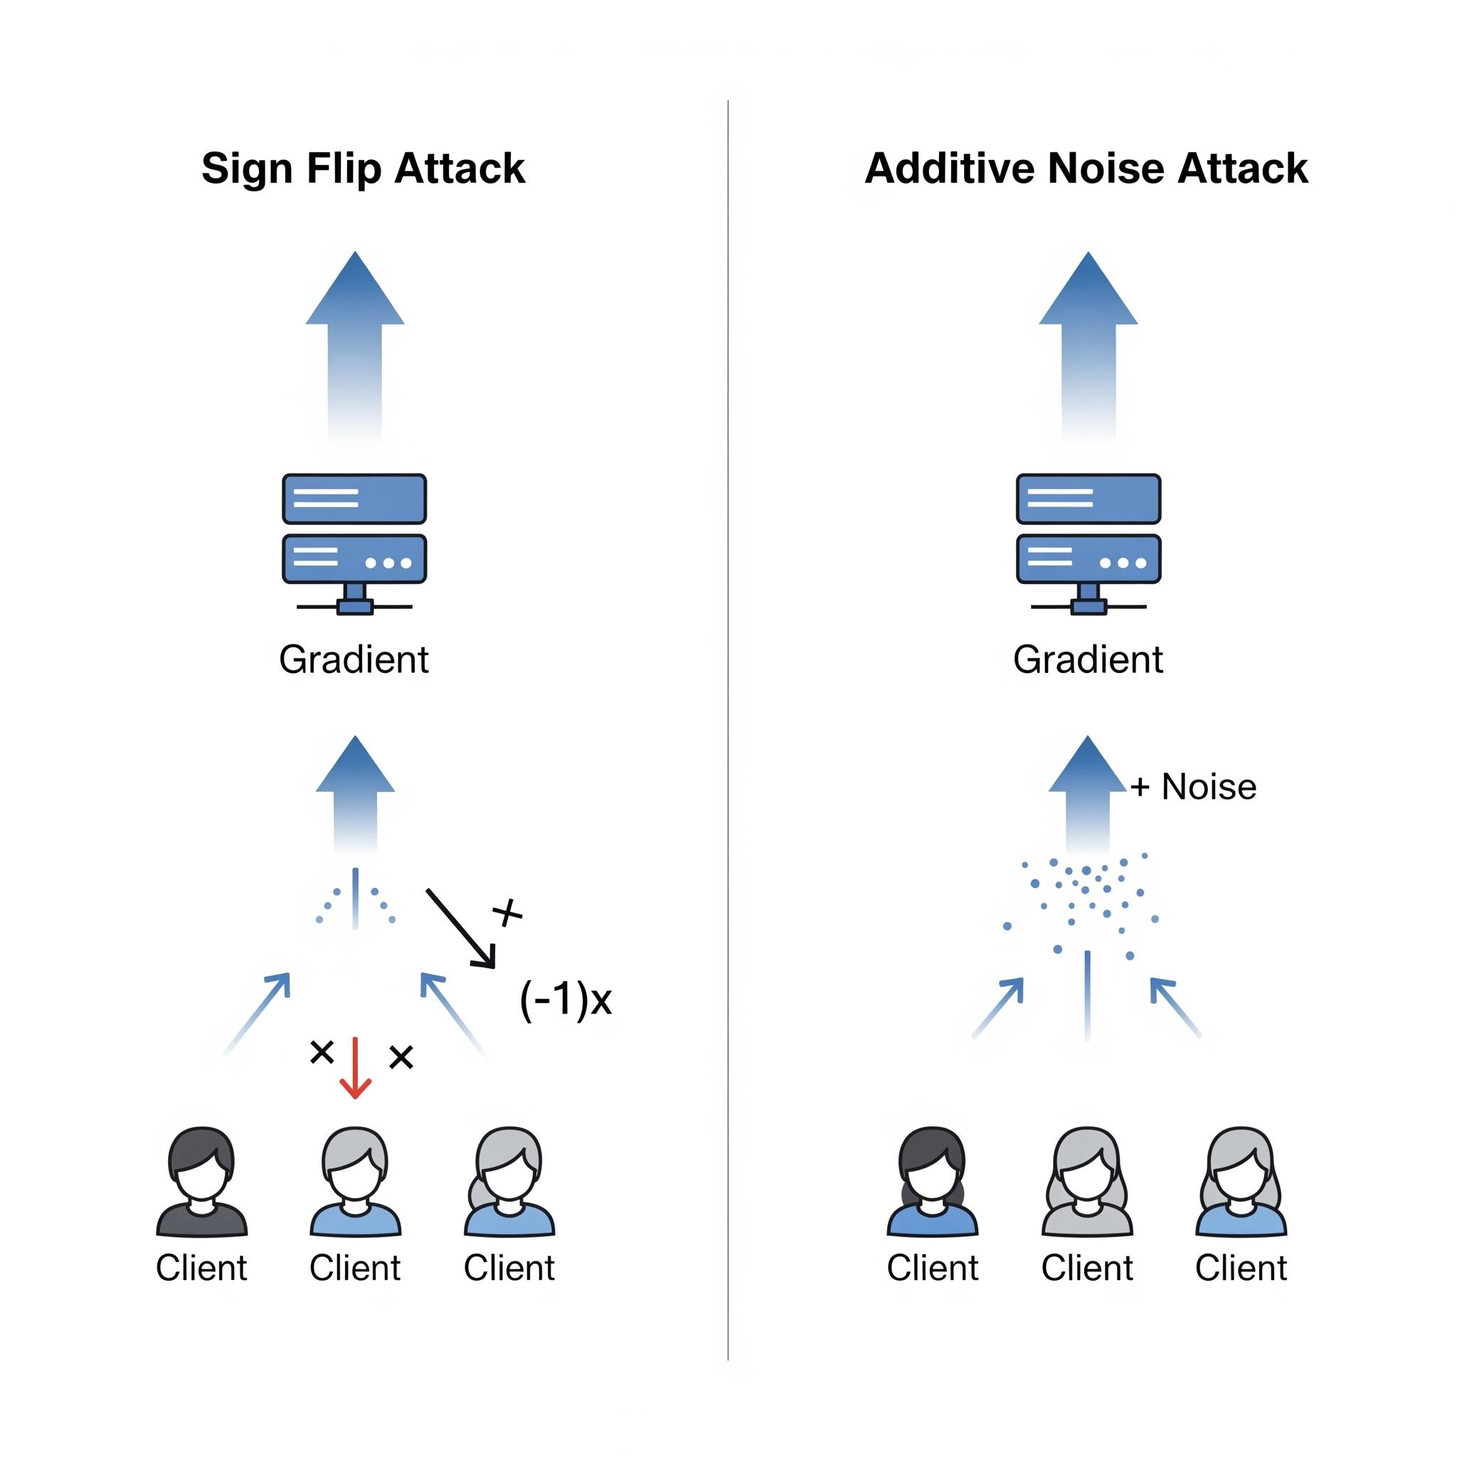
Problem Statement
The server is vulnerable to "Byzantine" clients. attackers can send poisoned model updates (e.g., `Sign Flip`, ‘Additive Noise) to corrupt the global model and prevent it from learning.

Slide 8
MOTIVATION
Why a new protocol
1
2
4
Year/Quarter/Month
The Fragility of FedAvg
Limitations of Robust Defenses
Objective title
Standard FL is not secure. A single attacker using simple methods (Sign-Flip, Noise) can destroy the global model. It also fails to handle "honest stragglers" in Non-IID settings.
Multi-Krum: Computationally slow (O(dn²) and brittle in Non-IID settings (mistakes diverse data for attacks).
CWMed: Robust but statistically inefficient; often converges slower (O(dn)) than weighted averages.

Slide 9
MOTIVATION
Why a new protocol
3
4
4
Year/Quarter/Month
The Security vs. Privacy Paradox
The "Quality Control" Gap
Current methods force a binary choice: Secure (Server sees updates) OR Private (Server sees nothing). There is a lack of hybrid protocols that solve both simultaneously.
Existing defenses are binary (Accept/Reject). They lack a Soft-Filtering mechanism to handle the "gray area"—clients that are honest but have noisy or low-quality data.

Slide 10
PROJECT ROADMAP

Slide 11
Project roadmap
Goal
Step 1
Step 2
Step 3
Step 4
Literature Review & Problem Formulation
Protocol Design
Implementation & Simulation Framework
Experimental Validation & Analysis
Design a Resilient and Robust aggregation protocol

Slide 12
PROPOSED PROTOCOL

Slide 13
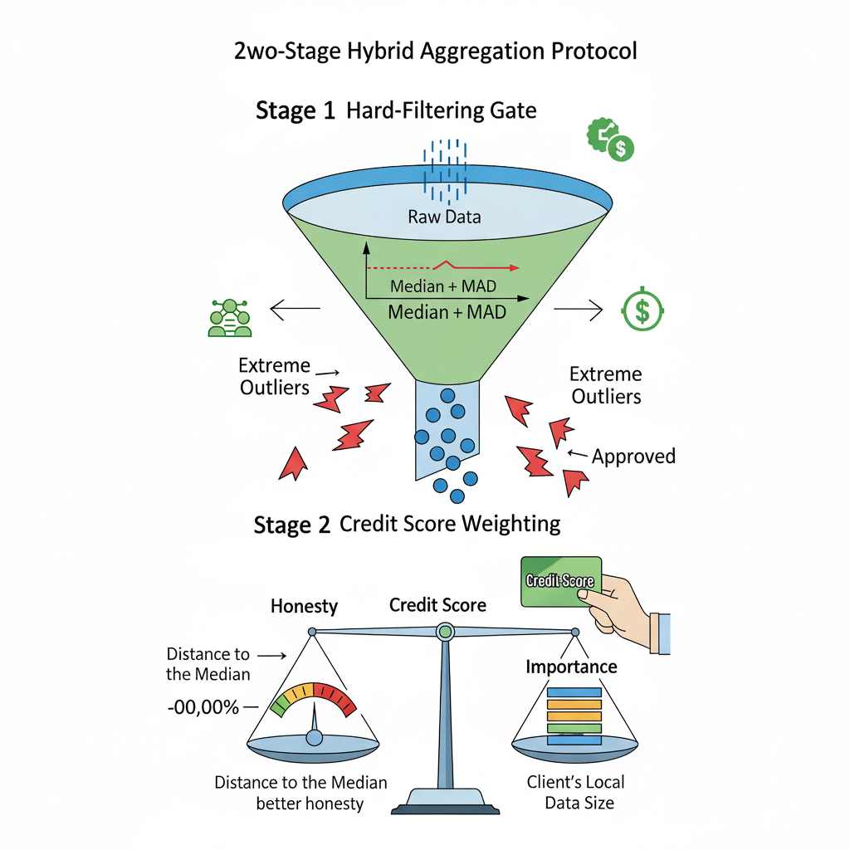
AEGIS
PROTOCOL

Slide 14
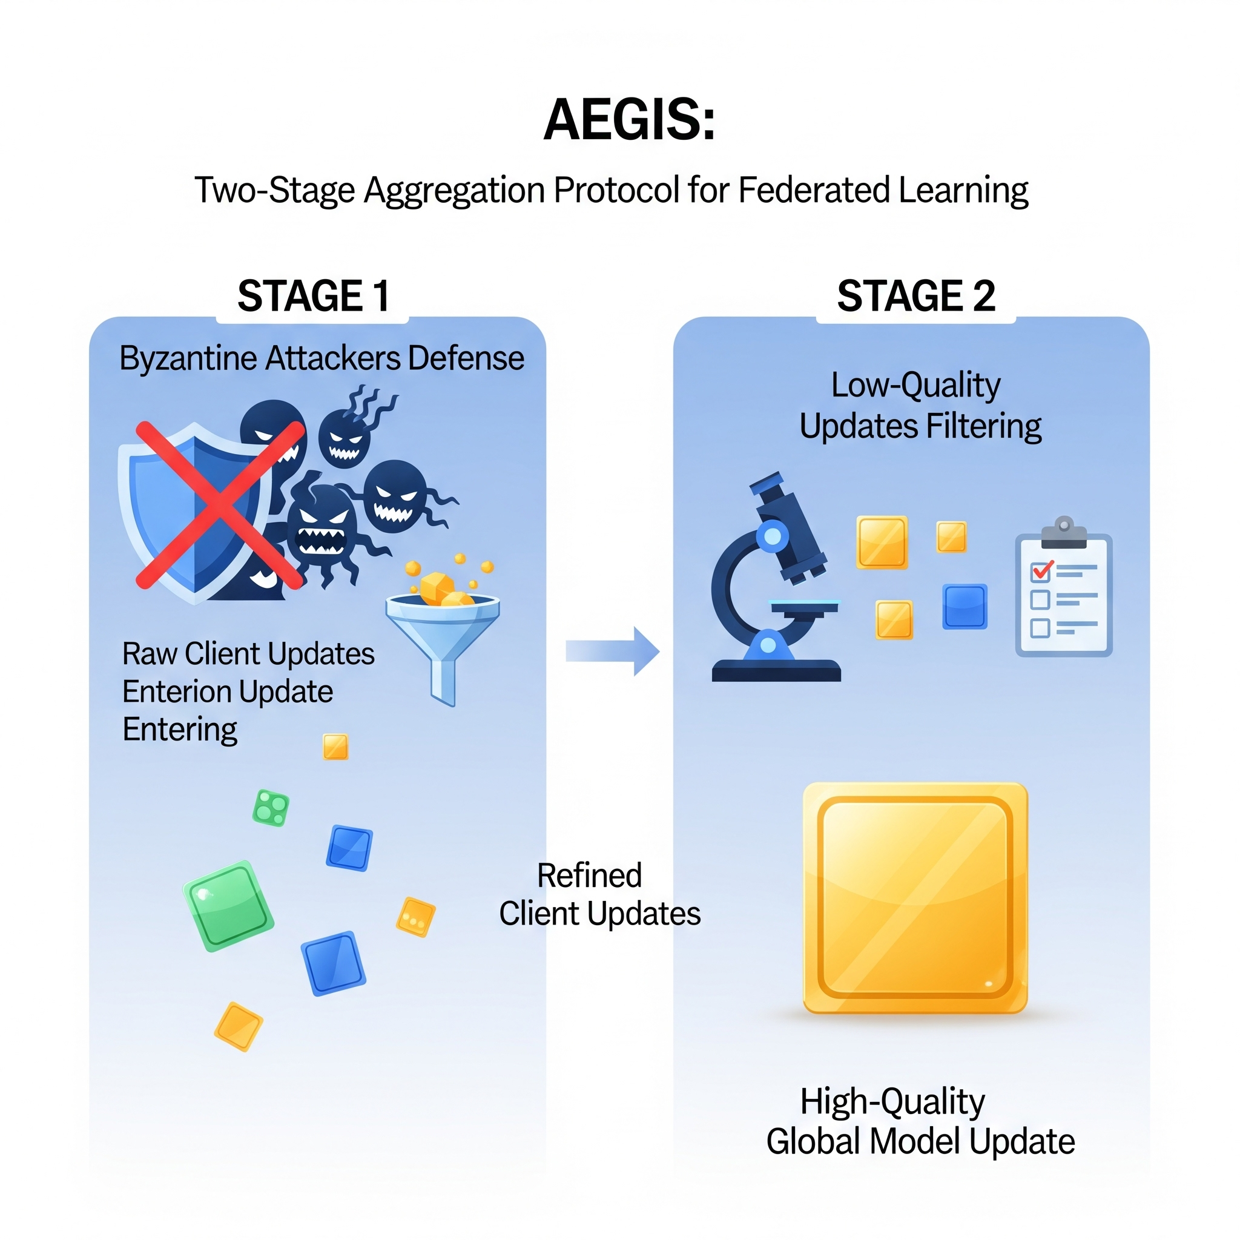
The solution
AEGIS AGGREGATOR PROTOCOL
Aegis is a novel, two-stage aggregation protocol designed for Federated Learning. Its purpose is to defend the global model from both malicious Byzantine attackers and low-quality updates from "honest-but-noisy" clients, ensuring a fast, stable, and highly accurate training process.
Aegis acts like a two-stage quality control system that "refines" the client updates in every single round.

Slide 15
AEGIS
Step 1 : Distribute Model and training- O(dn)
Server distribute model among clients.
Clients train the model
Server receives k model updates
Server also receives n_{k} (data points) per client
Step 2 : Robust center
Stack all k vectors - O(dk)
Calculate element wise median W_{median}. - O(dk)

Slide 16
AEGIS
3. Step 3 : Anomaly Score - O(dk)
Initialize empty Anomaly Score List S_{k}
Anomaly score, S_{k}= || W_{k}^{t} - W_{Median}||₂
Cost per client:- O(d)
For k clients:- O(dk)
Honest client - Low Anomaly Score
Byzantine clients - High Anomaly Score

Slide 17
AEGIS
4. Step 4 : Credit Scores - O(k)
Inverse of Anomaly Score.
Get total data points n = ∑ n_{k} :- O(k)
Initialize empty list for Credit Scores, 𝝱
Calculate Credit Scores - O(k)
C_{k} = (n_{k}/n) * (1/S_{k})
Sum all credit scores - O(k)
C_{Total} = ∑C_{k}
Normalize - O(k)
𝝱_{k}^{t} = C_{k}/ C_{Total}

Slide 18
AEGIS
5. Step 5 : Thresholding
Calculate Median of Anomaly Score, S_{Median} - O(k)
Find the Deviation - O(k)
D_{k} = |S_{k} - S_{Median}|
Make list of all D_{k}
Find Median Absolute Deviation, D = Median [D_{k}] :- O(k)
Set Threshold - O(1)
T = S_{Median} - (3 x D)
Apply Thresholding - O(k)
If S_{k} > T, - Outlier, Discard
If S_{k} ≤ T, - Honest, Accept

Slide 19
AEGIS
6. Step 6 : Aggregate - O(kd)
W^{t}_{Global} = ∑𝝱_{i}W_{i}
Multiply vector W_{i}(dim d) by scalar βi​: O(d)
Sum across m clients : m⋅O(d) → worst-case O(Kd)

Slide 20
AEGIS
Total Time Complexity - O(kd)

Slide 21
PROJECT SETUP

Slide 22
Project Architecture : Modular
main.py
Orchestration
client.py
Local training at the client end
server.py
Distribute and receive weights
Calculates Anomaly and Credit Scores

Slide 23
Project Architecture : Modular
data_util.py
Download the dataset and partition it amongst the clients
config.py
Global configuration settings for the FL enviornment
aggragator.py
Implement all the aggregator ( Fedavg, CWMed, Krum, Aegis)

Slide 24
Project Setup
Dataset
Data Split
Attack Types
Sign Flip
Additive noise
CIFAR10
Unbalanced Data Split
Model
CNN
Byzantine %
30% - 40%
Clients
30
Total Rounds
80

Slide 25
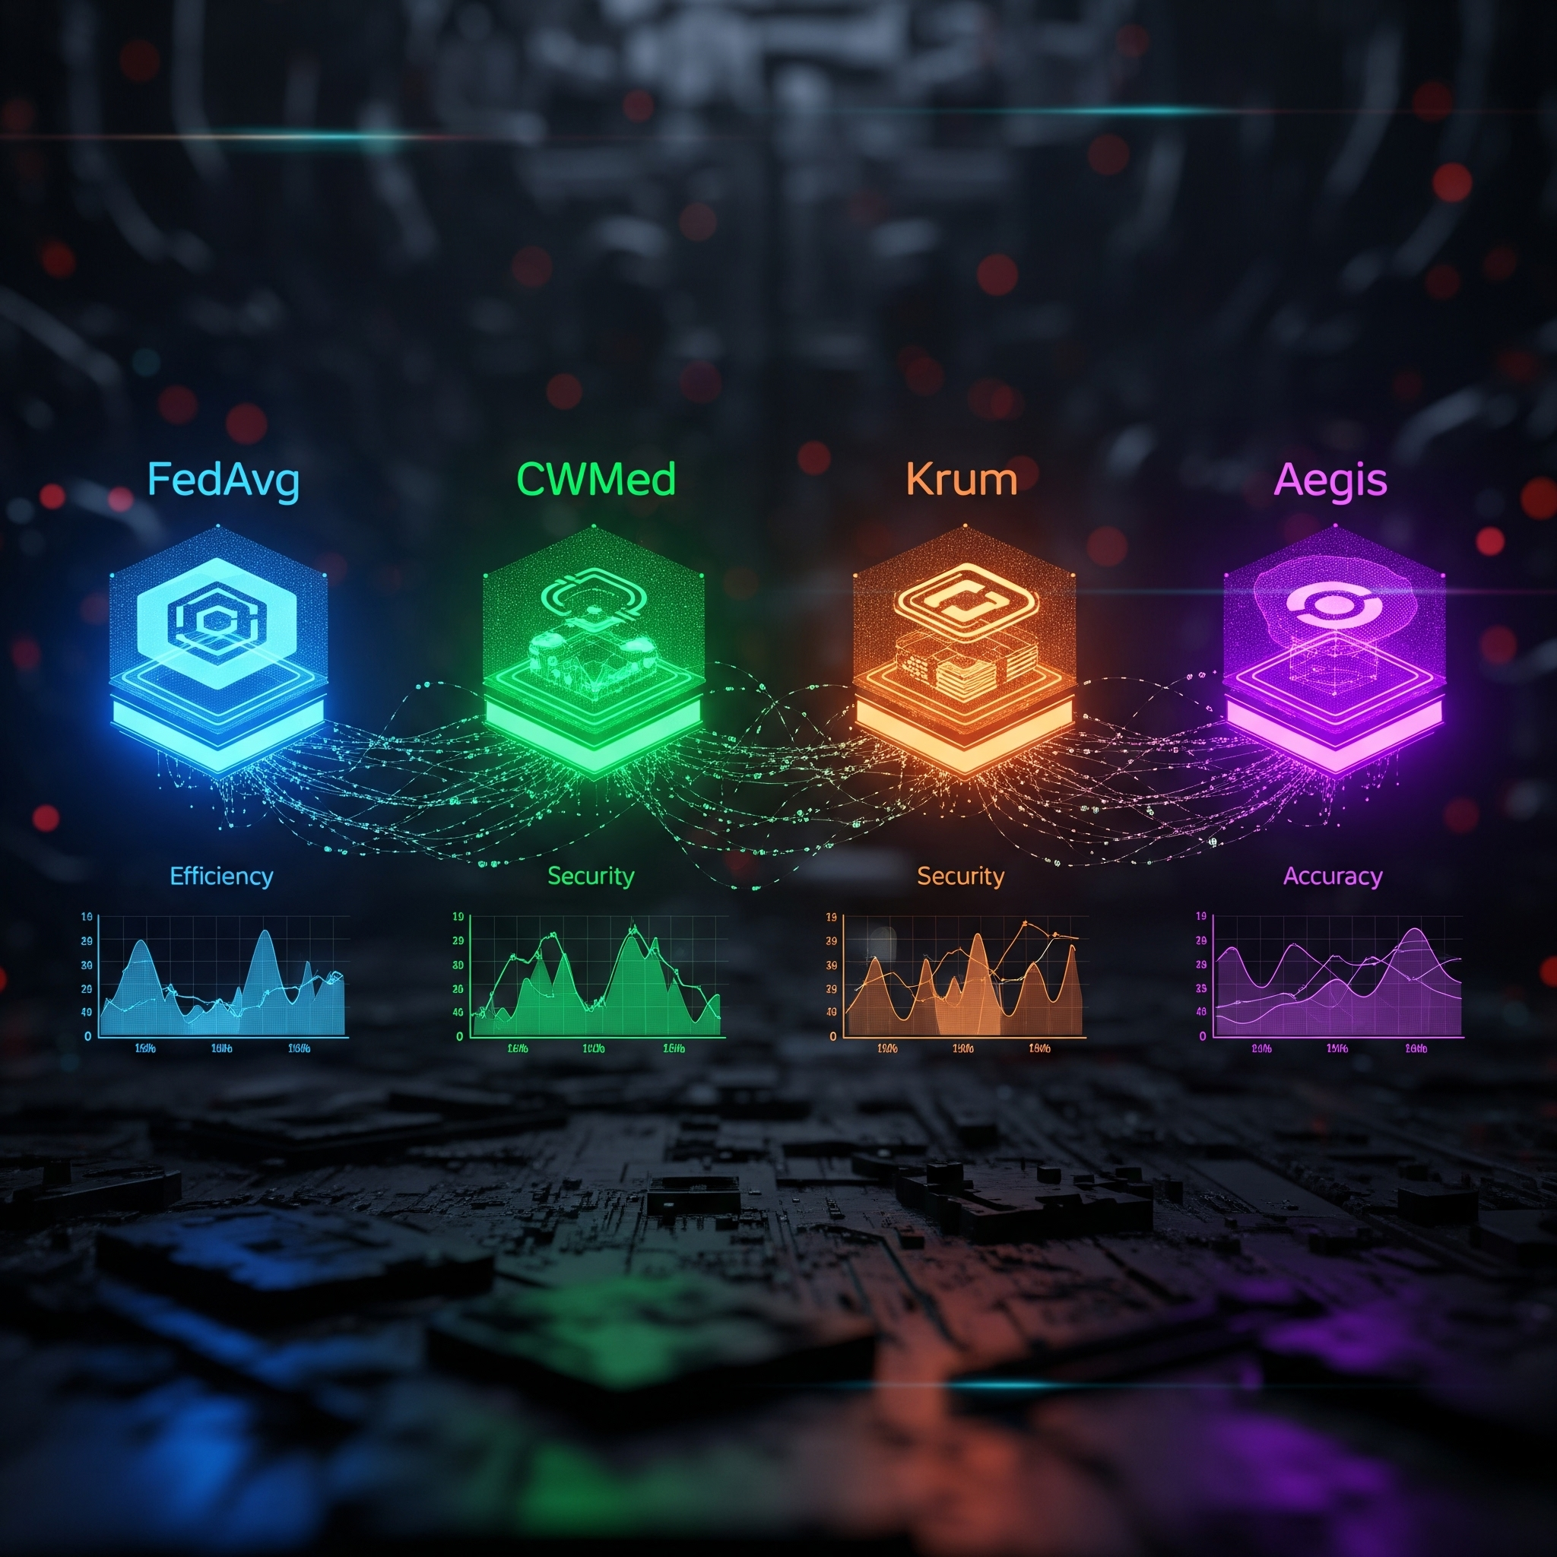
Aggregators under
test
Baselines
Our Protocol
Year/Quarter/Month
FedAvg
CWMed
Krum
Aegis

Slide 26
EXPERIMENTS OUTCOMES

Slide 27
Experiment Simulations : Phase 1 Simple MNIST, Balanced IID

Slide 28
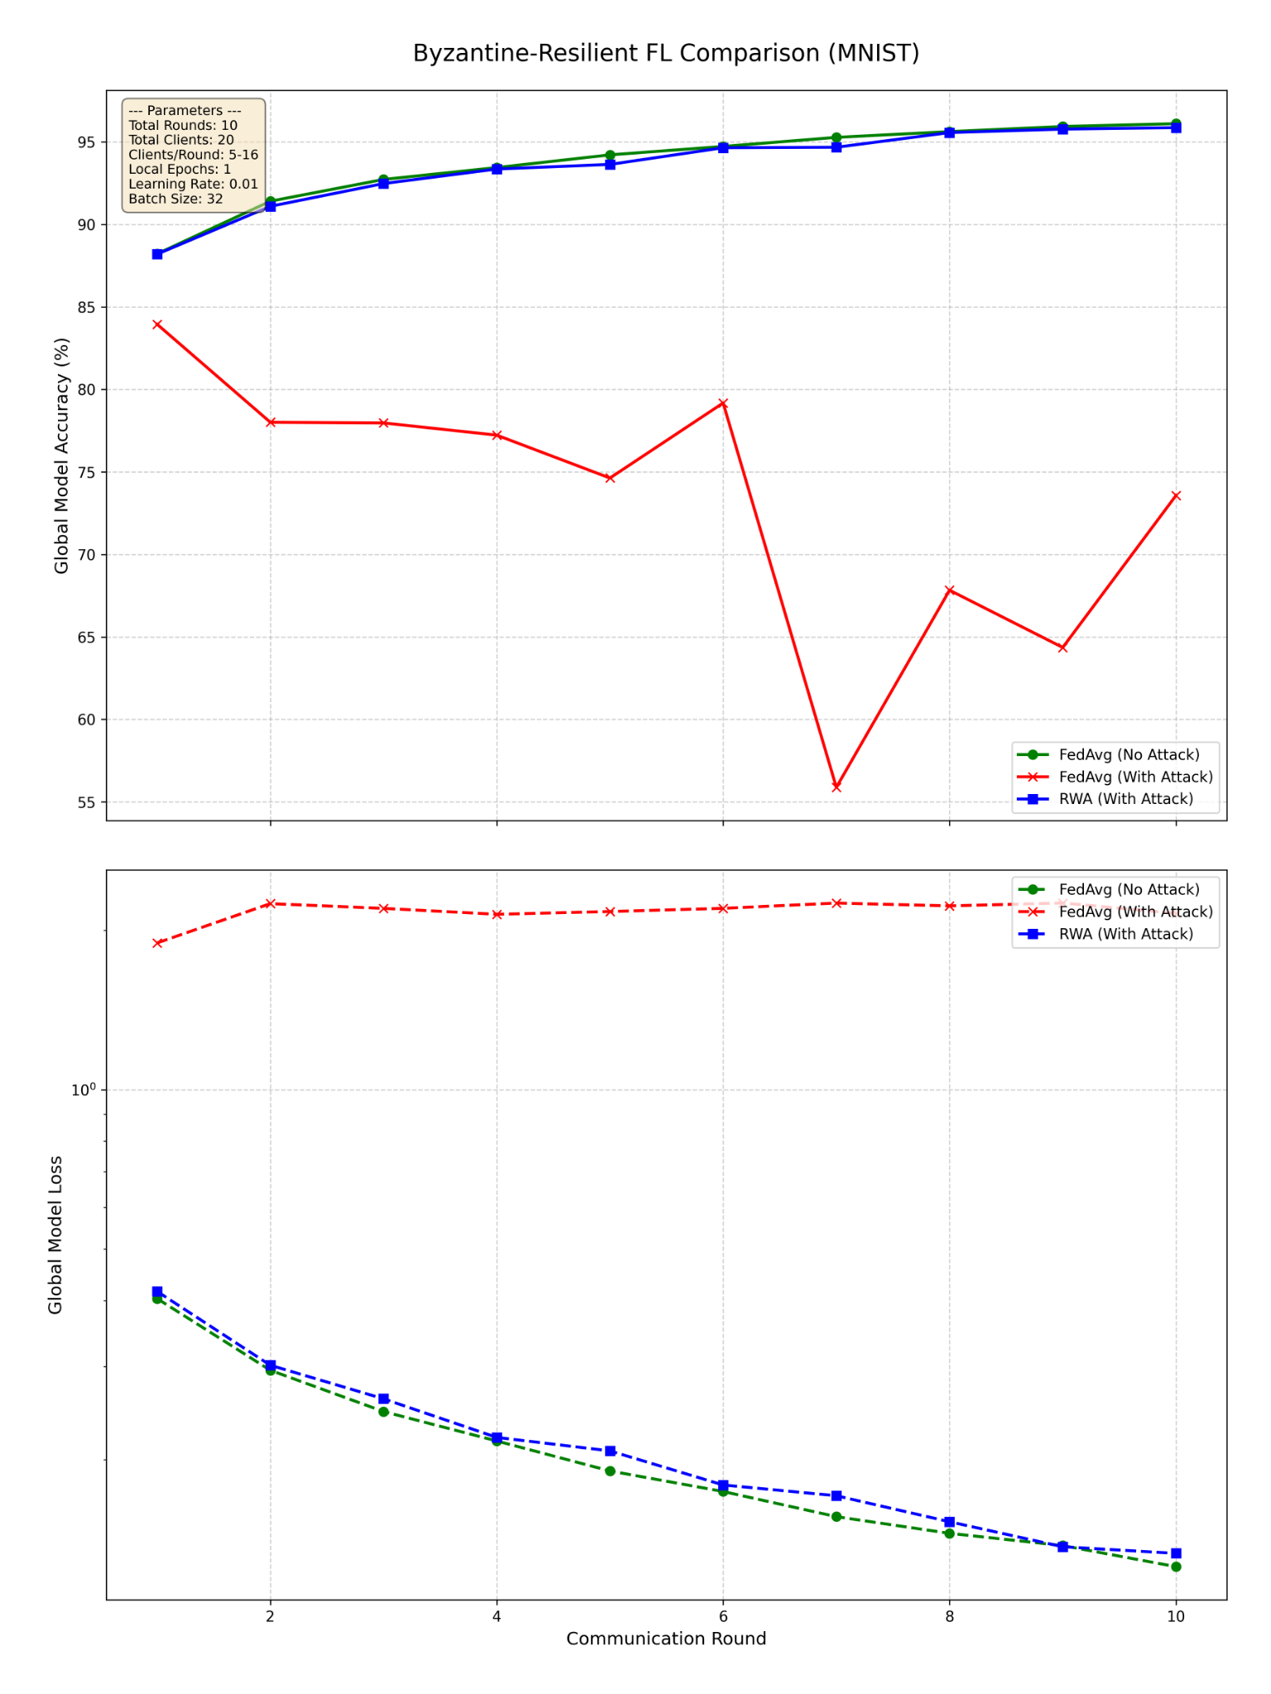
Result - Simulation 1
Total Rounds - 10
Total Clients - 20
Clients/Round - Max 80 %
Local Epocs - 01
LR - 0.01
Batch Size - 32
Dataset - MNIST
Data Split - Balanced IID
FedAvg (No Attack)
FedAvg (With Attack)
Aegis (With Attack)
FedAvg (No Attack)
FedAvg (With Attack)
Aegis (With Attack)

Slide 29
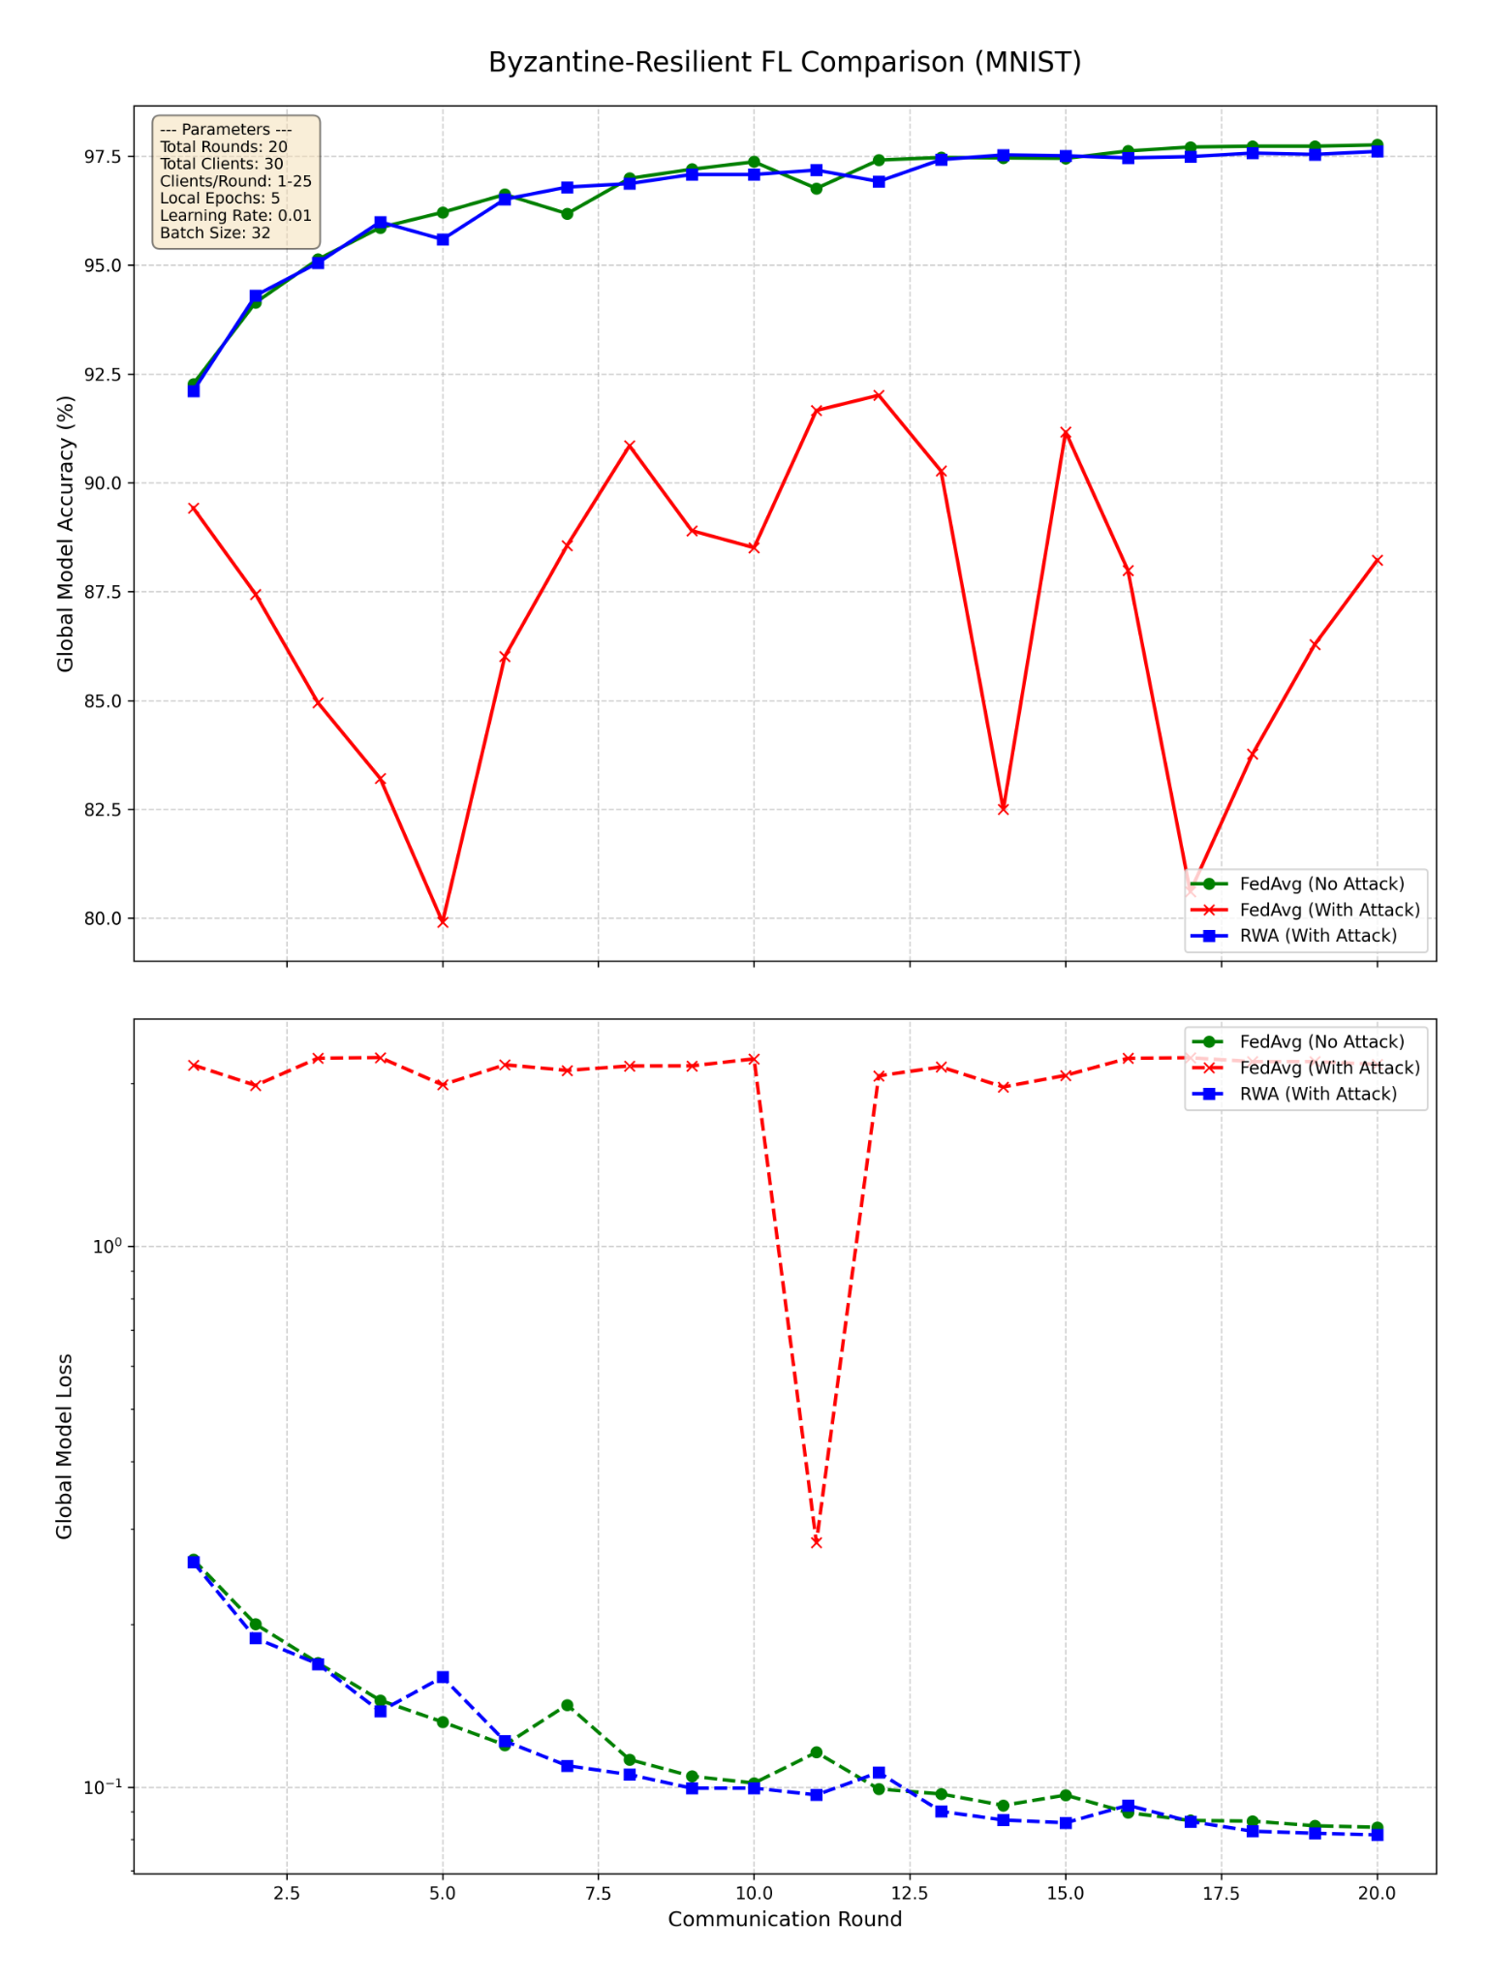
Result - Simulation 2
Total Rounds - 20
Total Clients - 30
Clients/Round - Max 80 %
Local Epocs - 05
LR - 0.01
Batch Size - 32
Dataset - MNIST
Data Split - Balanced IID
FedAvg (No Attack)
FedAvg (With Attack)
Aegis (With Attack)
FedAvg (No Attack)
FedAvg (With Attack)
Aegis (With Attack)

Slide 30
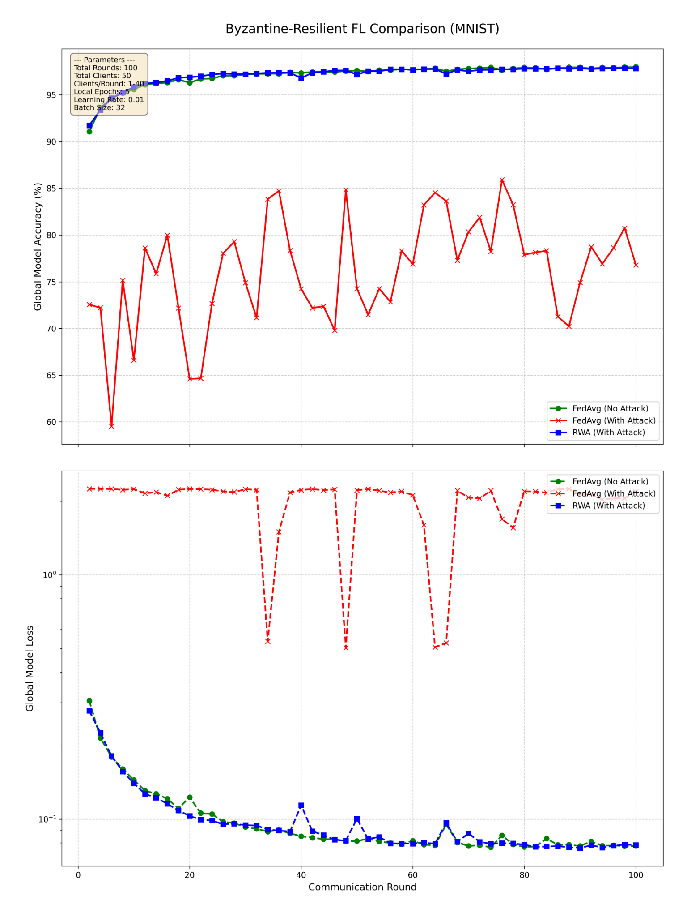
Result - Simulation 3
Total Rounds - 100
Total Clients - 50
Clients/Round - Max 80 %
Local Epocs - 05
LR - 0.01
Batch Size - 32
Dataset - MNIST
Data Split - Balanced IID
FedAvg (No Attack)
FedAvg (With Attack)
Aegis (With Attack)
FedAvg (No Attack)
FedAvg (With Attack)
Aegis (With Attack)

Slide 31
Experiment Simulations : Phase 2
CIFAR10, Additive Noise

Slide 32
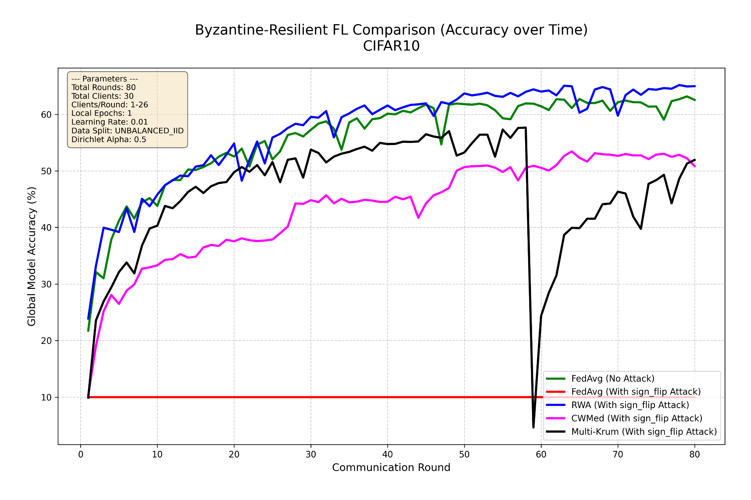
Result - Simulation 4
Accuracy Comparison
Total Rounds - 80
Total Clients - 30
Clients/Round - Max 80 %
Local Epocs - 01
LR - 0.01
Batch Size - 32
Dataset - CIFAR10
Data Split - Unbalanced IID
FedAvg (No Attack)
FedAvg (With Sign Flip Attack)
Aegis (With Sign Flip Attack)
CWMed (With Sign Flip Attack)
Multi Krum (With Sign Flip Attack)

Slide 33
Result - Simulation 4
FedAvg (Red) instantly fails, flatlining at 10% accuracy.
Multi-Krum (Black) is unstable and suffers a catastrophic failure, proving it is vulnerable to collusion in an Unbalanced IID setting.
CWMed (Magenta) is stable but converges to a lower accuracy.
Aegis (Blue) is stable, converges quickly, and achieves the highest final accuracy.
FedAvg (No Attack)
FedAvg (With Sign Flip Attack)
Aegis (With Sign Flip Attack)
CWMed (With Sign Flip Attack)
Multi Krum (With Sign Flip Attack)

Slide 34
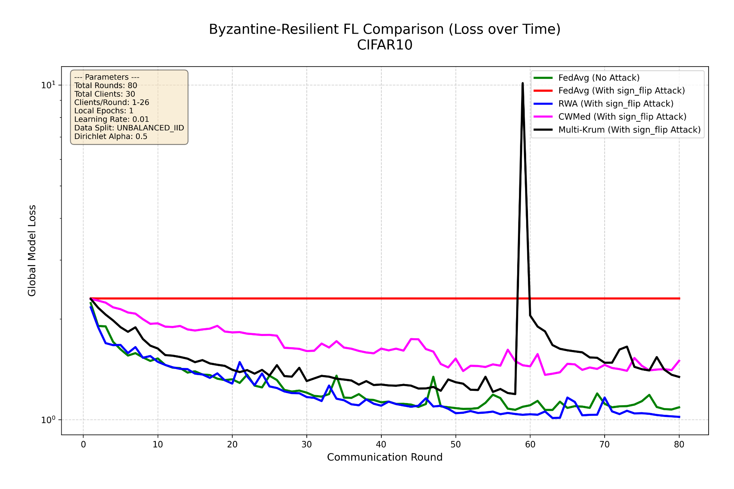
Result - Simulation 4
Convergence Comparison
Total Rounds - 80
Total Clients - 30
Clients/Round - Max 80 %
Local Epocs - 01
LR - 0.01
Batch Size - 32
Dataset - CIFAR10
Data Split - Unbalanced IID
FedAvg (No Attack)
FedAvg (With Sign Flip Attack)
Aegis (With Sign Flip Attack)
CWMed (With Sign Flip Attack)
Multi Krum (With Sign Flip Attack)

Slide 35
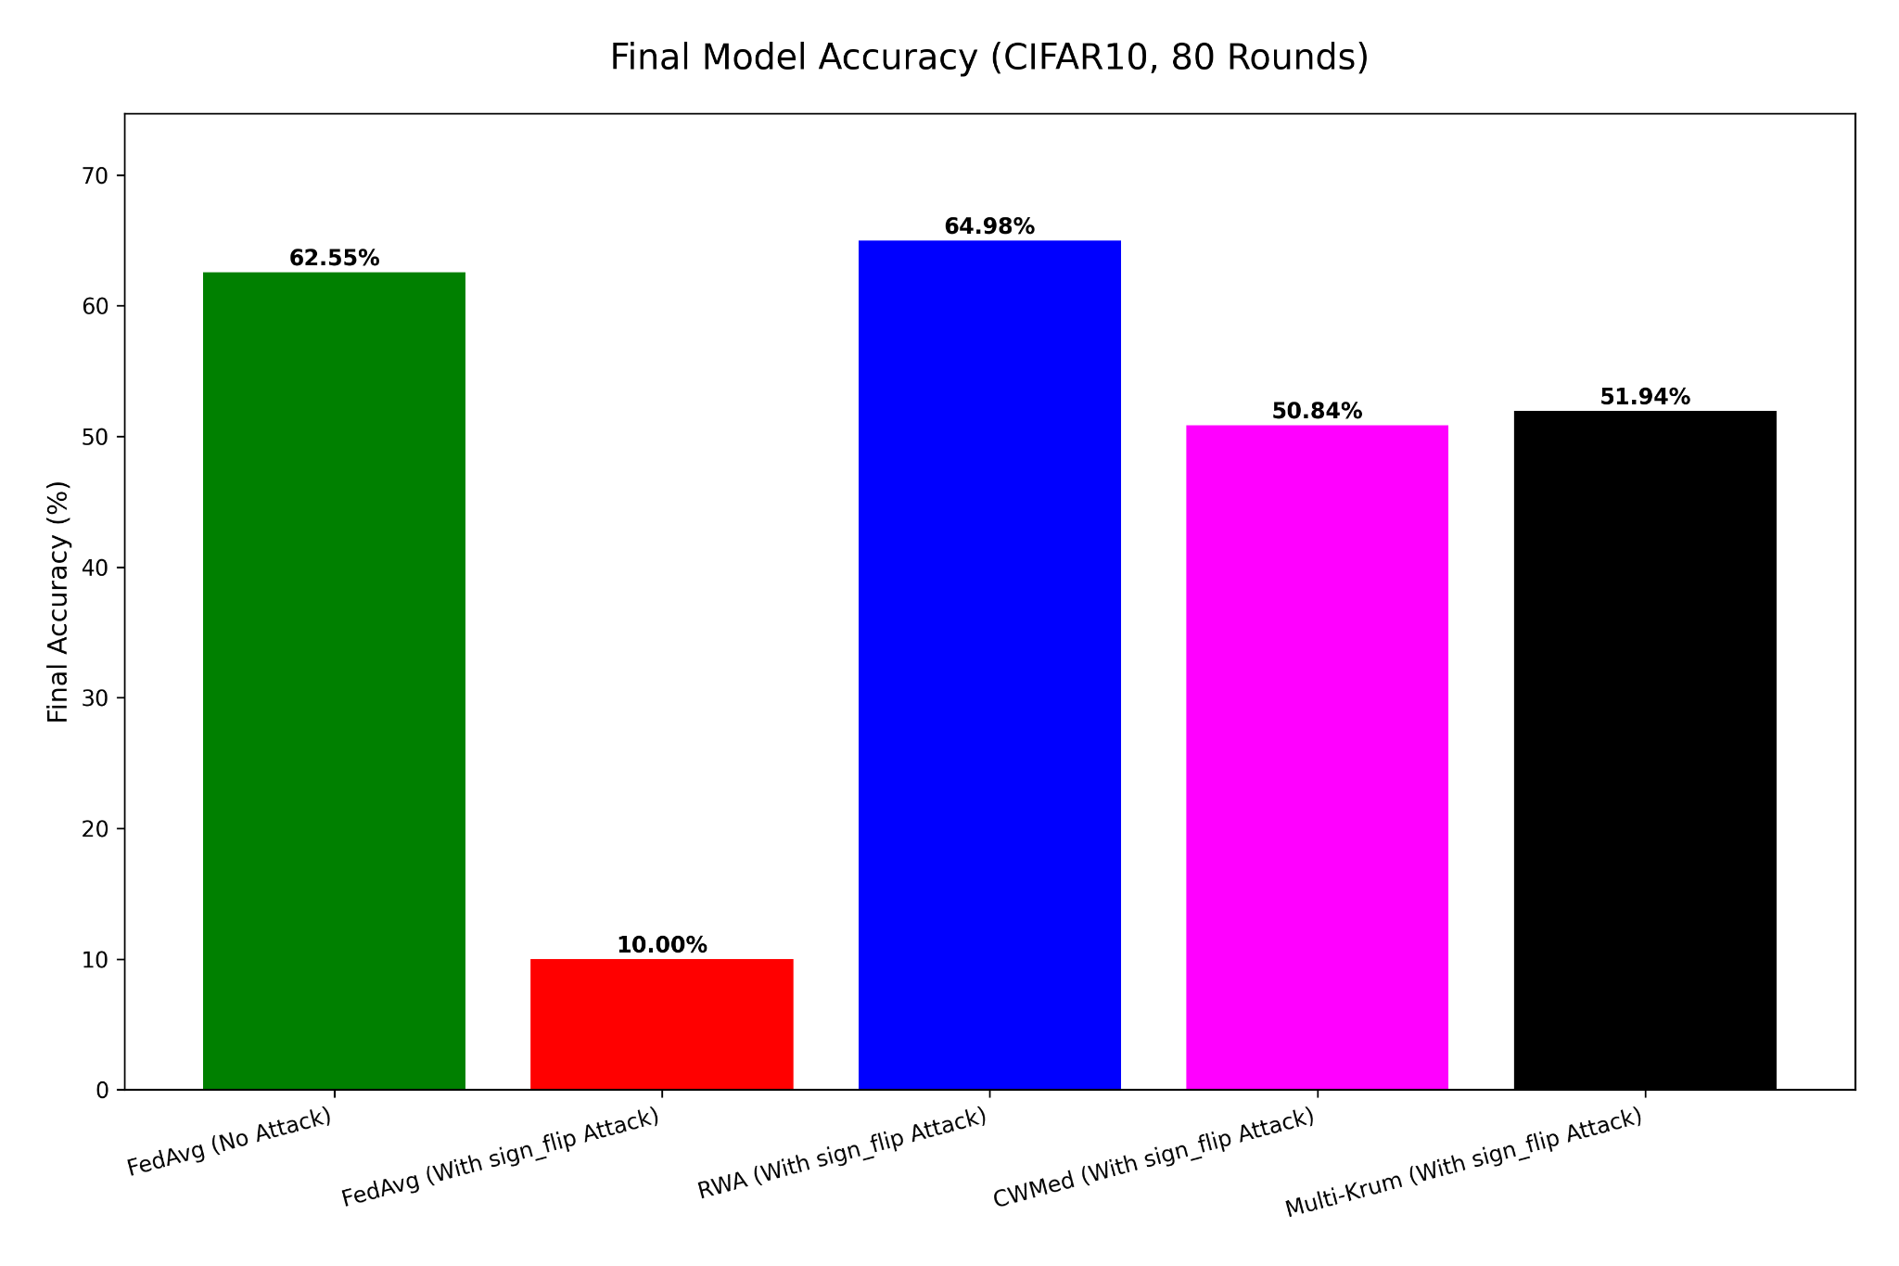
Result - Simulation 4
Convergence Comparison
Total Rounds - 80
Total Clients - 30
Clients/Round - Max 80 %
Local Epocs - 01
LR - 0.01
Batch Size - 32
Dataset - CIFAR10
Data Split - Unbalanced IID
AEGIS (With Sign Flip attack)

Slide 36
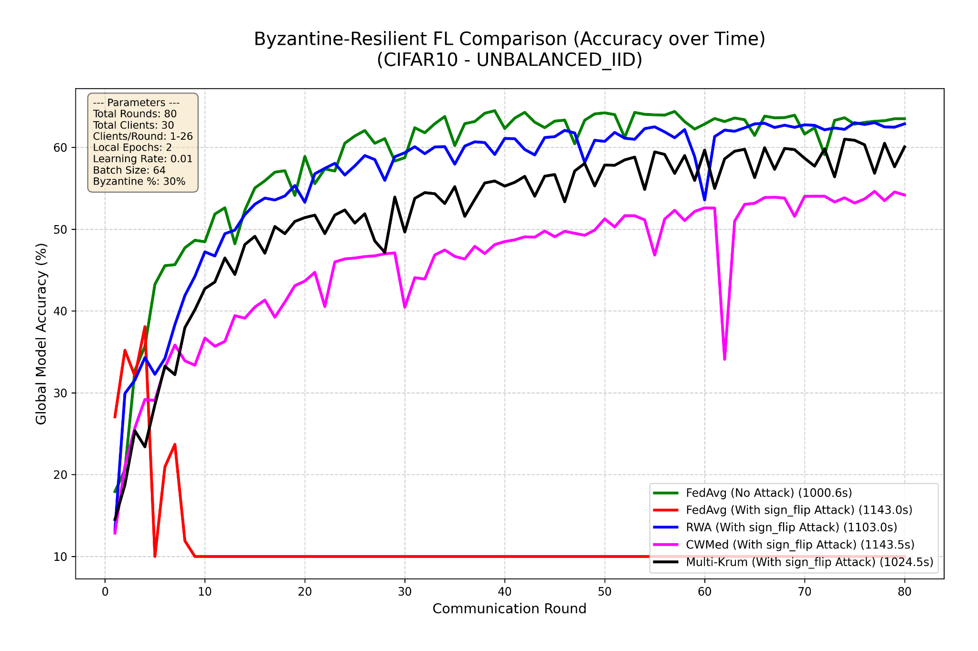
Result - Simulation 5
Accuracy Comparison
Total Rounds - 80
Total Clients - 30
Clients/Round - Max 80 %
Local Epocs - 02
LR - 0.01
Batch Size - 64
Dataset - CIFAR10
Data Split - Unbalanced IID
FedAvg (No Attack)
FedAvg (With Sign Flip Attack)
Aegis (With Sign Flip Attack)
CWMed (With Sign Flip Attack)
Multi Krum (With Sign Flip Attack)

Slide 37
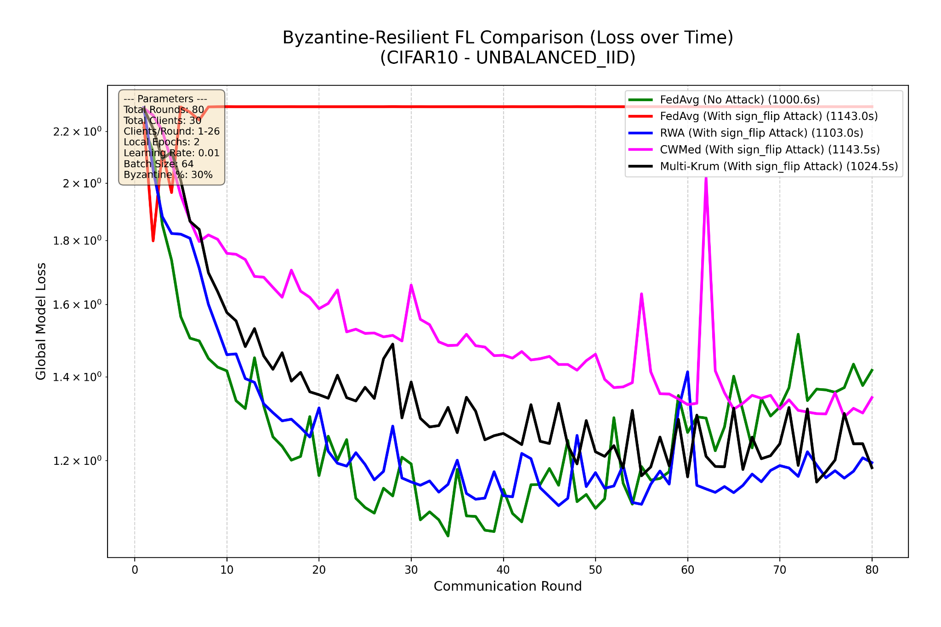
Result - Simulation 5
Convergence Comparison
Total Rounds - 80
Total Clients - 30
Clients/Round - Max 80 %
Local Epocs - 02
LR - 0.01
Batch Size - 64
Dataset - CIFAR10
Data Split - Unbalanced IID
FedAvg (No Attack)
FedAvg (With Sign Flip Attack)
Aegis (With Sign Flip Attack)
CWMed (With Sign Flip Attack)
Multi Krum (With Sign Flip Attack)

Slide 38
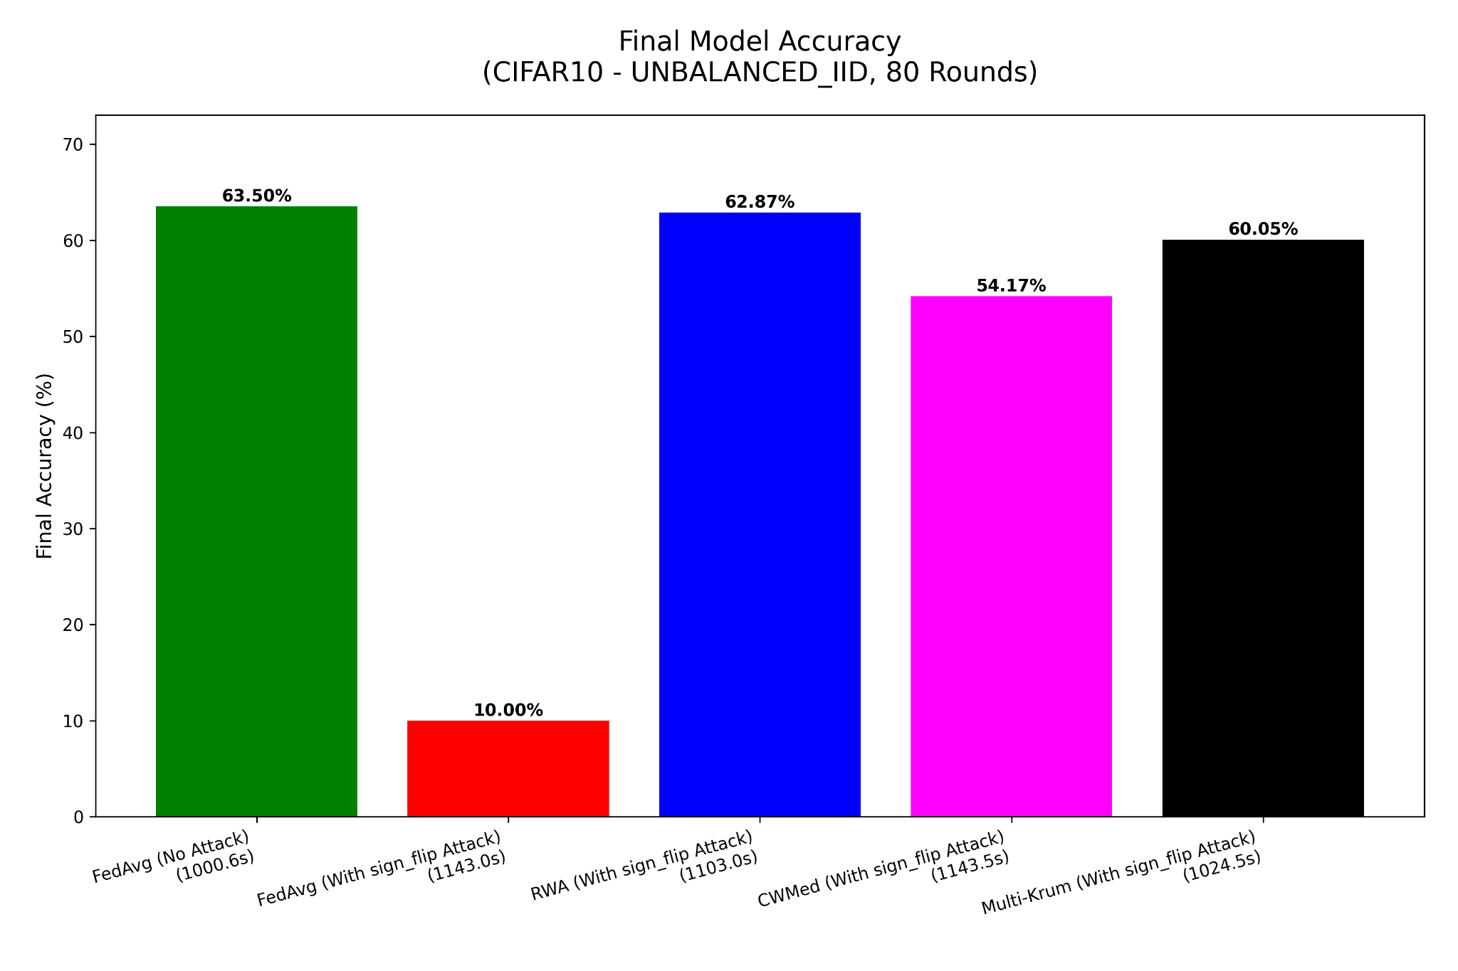
Result - Simulation 5
Accuracy Comparison
Total Rounds - 80
Total Clients - 30
Clients/Round - Max 80 %
Local Epocs - 02
LR - 0.01
Batch Size - 64
Dataset - CIFAR10
Data Split - Unbalanced IID

Slide 39
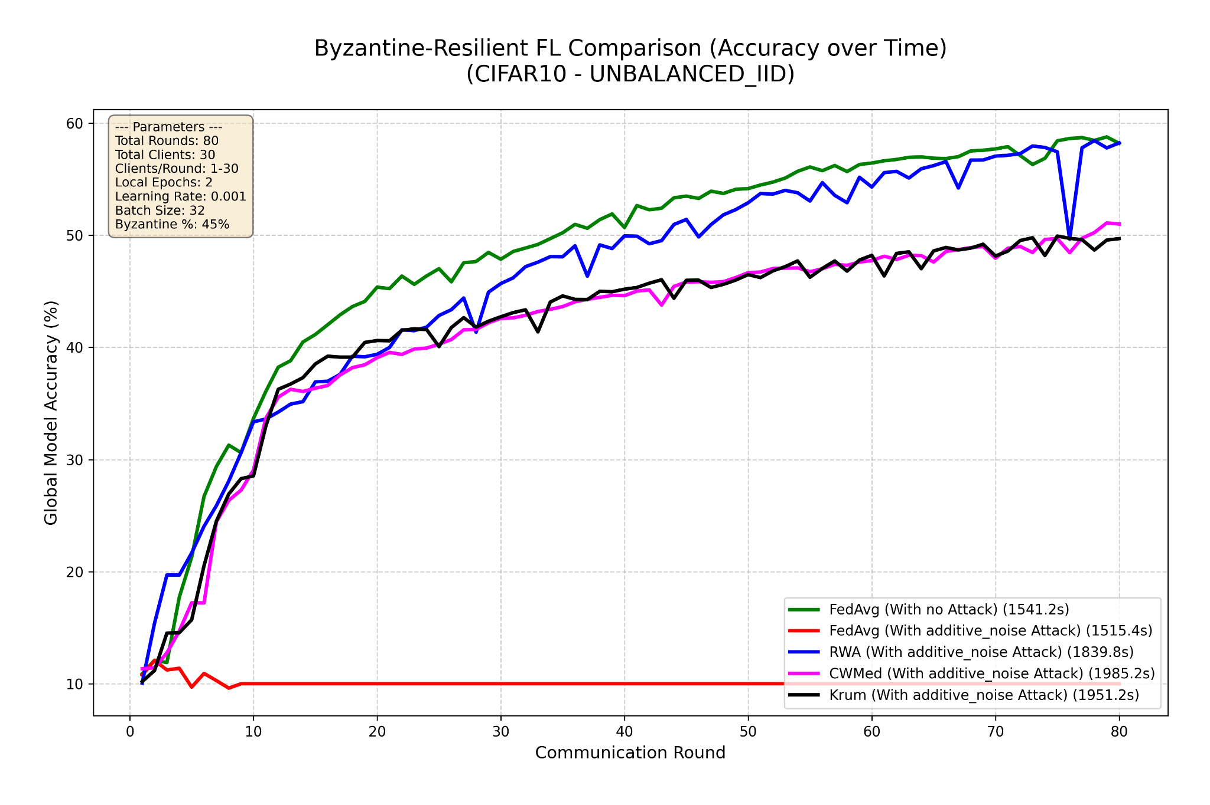
Result - Simulation 5
Accuracy Comparison
Total Rounds - 80
Total Clients - 30
Clients/Round - Max 100 %
Local Epocs - 02
LR - 0.001
Batch Size - 32
Dataset - CIFAR10
Data Split - Unbalanced IID
Byzantine% - 45%
Attack Type - Additive noise
FedAvg (No Attack)
FedAvg (With Additive noise Attack)
Aegis (With Additive noise Attack)
CWMed (With Additive noise Attack)
Multi Krum (With Additive noise Attack)

Slide 40
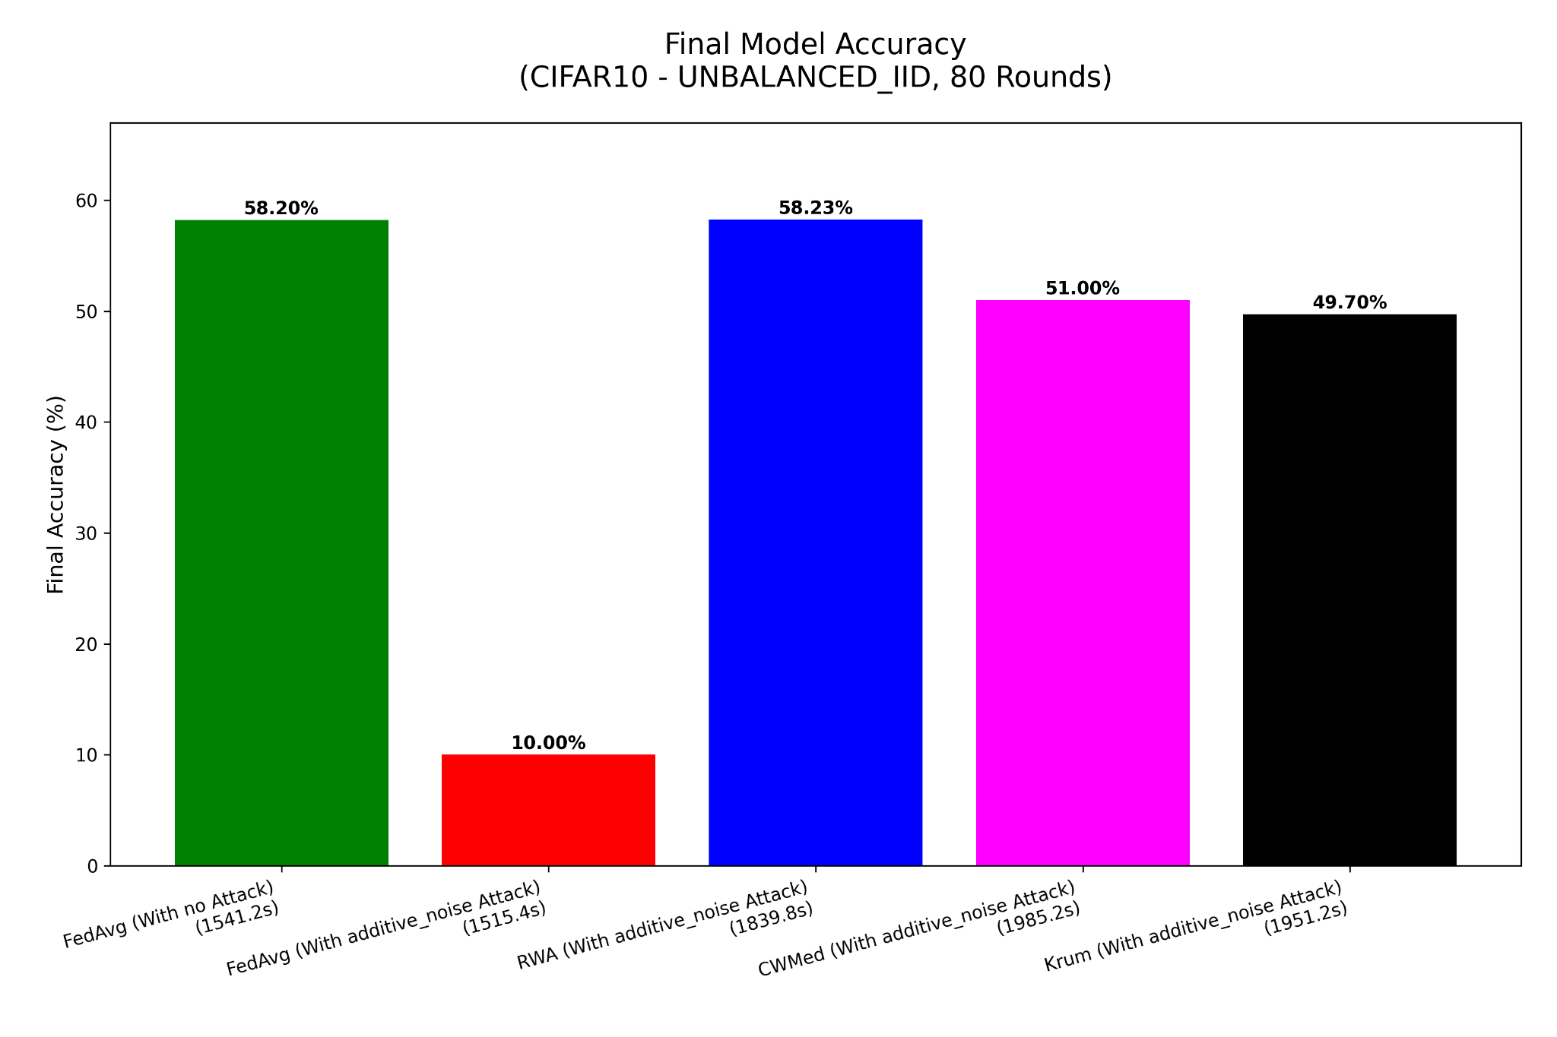
Result - Simulation 5
Accuracy Comparison
Total Rounds - 80
Total Clients - 30
Clients/Round - Max 100 %
Local Epocs - 02
LR - 0.001
Batch Size - 32
Dataset - CIFAR10
Data Split - Unbalanced IID
Byzantine% - 45%
Attack Type - Additive noise

Slide 41
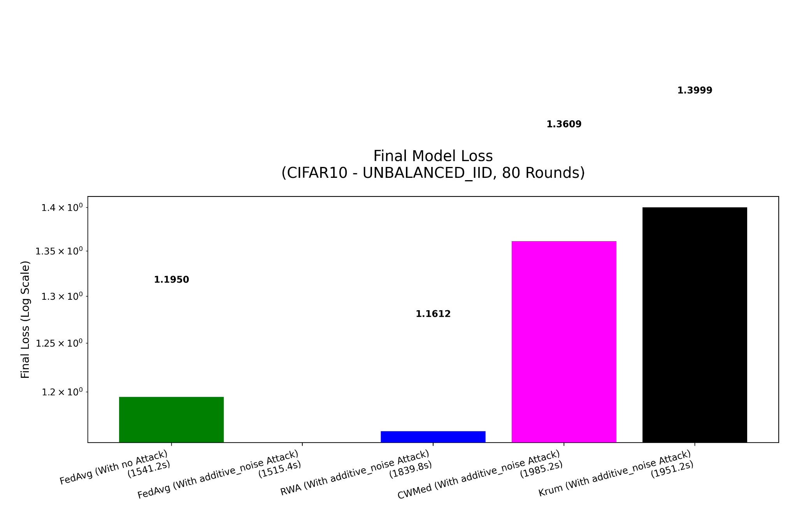
Result - Simulation 5
Loss Comparison
Total Rounds - 80
Total Clients - 30
Clients/Round - Max 100 %
Local Epocs - 02
LR - 0.001
Batch Size - 32
Dataset - CIFAR10
Data Split - Unbalanced IID
Byzantine% - 45%
Attack Type - Additive noise

Slide 42
Experiment Simulations : Phase 3
The 50% Theoretical Upper Bound

Slide 43
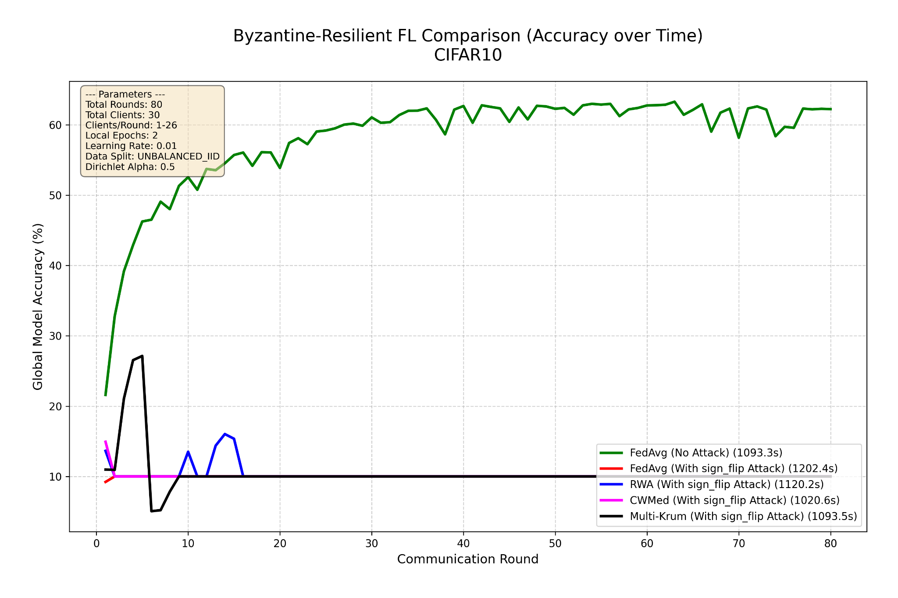
Result - Simulation 5
Accuracy Comparison
Total Rounds - 80
Total Clients - 30
Clients/Round - Max 80%
Local Epocs - 02
LR - 0.01
Batch Size - 32
Dataset - CIFAR10
Data Split - Unbalanced IID
Byzantine% - 50%
Attack Type - Sign Flip

Slide 44
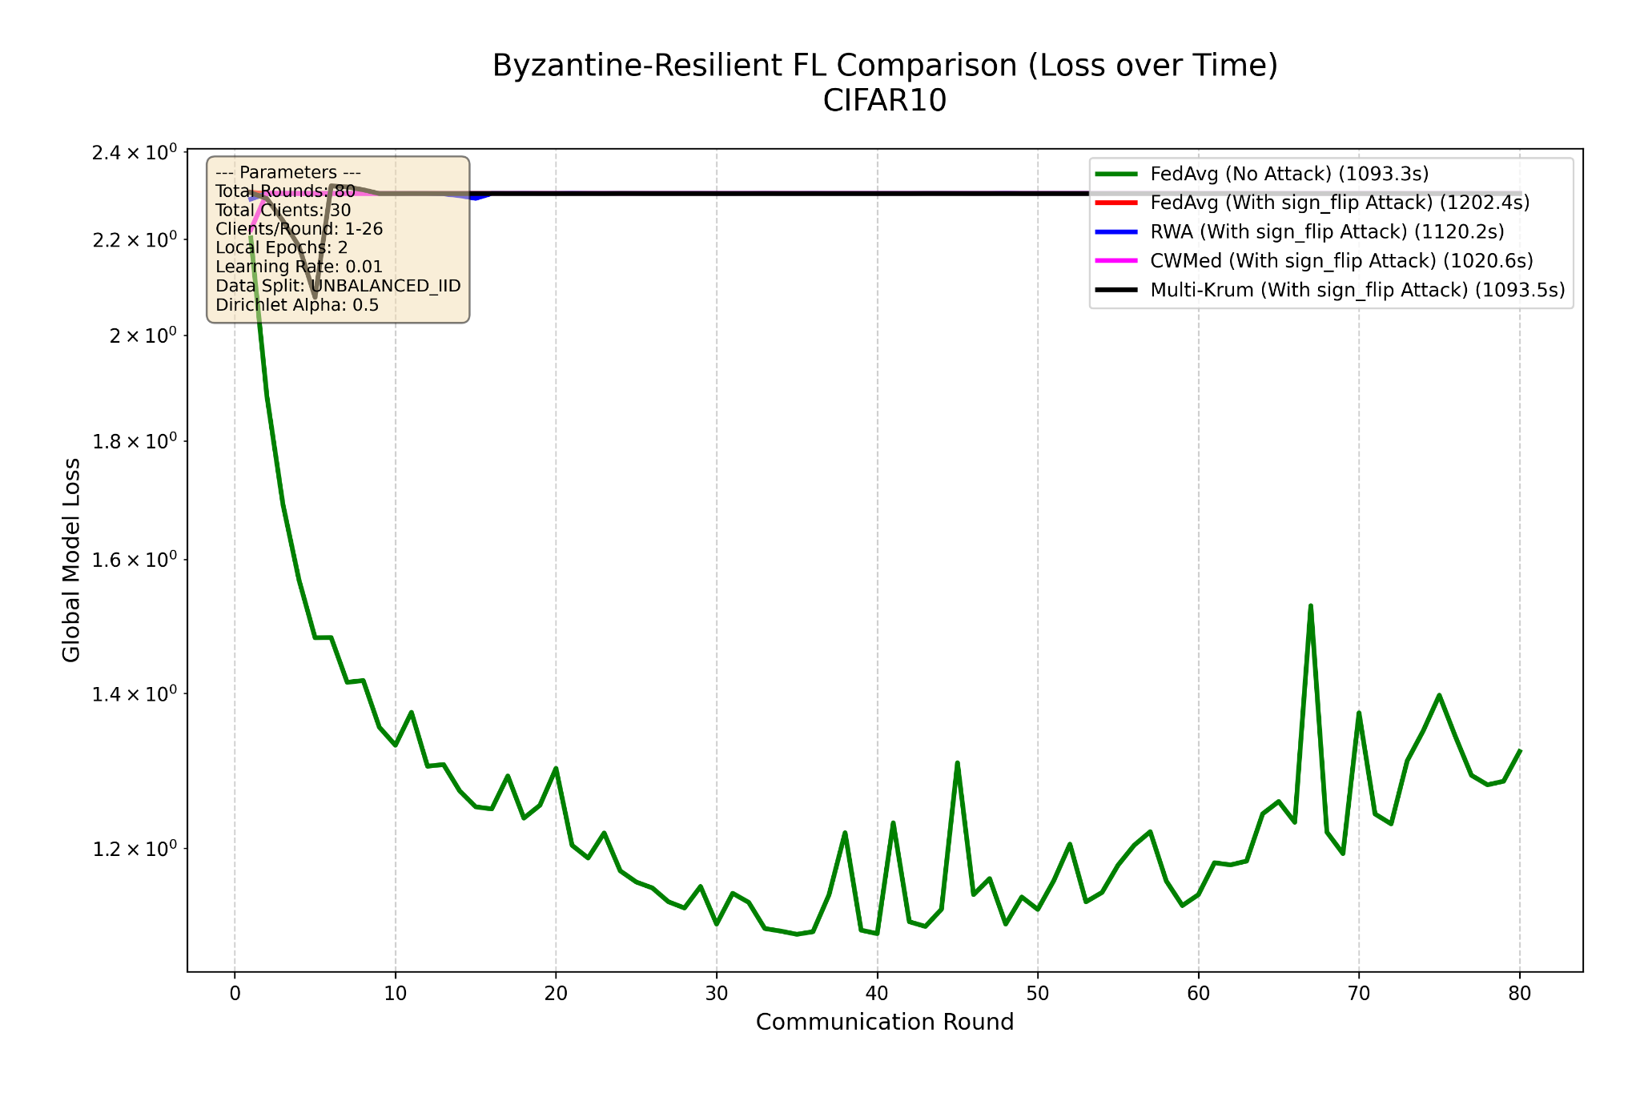
Result - Simulation 5
Convergence Comparison
Total Rounds - 80
Total Clients - 30
Clients/Round - Max 100 %
Local Epocs - 02
LR - 0.001
Batch Size - 32
Dataset - CIFAR10
Data Split - Unbalanced IID
Byzantine% - 50%
Attack Type - Sign Flip

Slide 45
FUTURE SCOPE

Slide 46
Future Scope
Privacy Integration
Defense Against Semantic Poisoning
1
2
Future work involves integrating Differential Privacy (DP) or Secure Multi-Party Computation (SMPC)
Implementing Backdoor or Clean-Label Attacks
Adaptive Thresholding Mechanism
Non IID settings
3
4
A loose threshold in earlier rounds and then making it stricter
Make the Aegis protocol more robust for Non IID environment

Slide 47
CONCLUSION

Slide 48
REFERENCES

Slide 49
References
H. B. McMahan, E. Moore, D. Ramage, S. Hampson, and B. A. Aguera-y-Arcas, “Communication-Efficient Learning of Deep Networks from Decentralized Data,” in Proc. AISTATS, 2017.
J. Geiping, H. Bauermeister, H. Dröge, and M. Moeller, “Inverting Gradients: How Easy Is It to Break Privacy in Federated Learning?,” NeurIPS, 2020.
L. Zhu, Z. Liu, and S. Han, “Deep Leakage from Gradients,” in NeurIPS, 2019 (arXiv:1906.08935).
D. Yin, Y. Chen, K. Ramchandran, and P. Bartlett, “Byzantine-Robust Distributed Learning: Towards Optimal Statistical Rates,” in Proc. ICML, 2018.
P. Blanchard, E. M. El Mhamdi, R. Guerraoui, and J. Stainer, “Machine Learning with Adversaries: Byzantine-Tolerant Gradient Descent,” in NeurIPS, 2017.
U. Shahul and J. Harshan, “FORTA: Byzantine-Resilient FL Aggregation via DFT-Guided Krum,” arXiv:2507.14588, 2025.
S. Ganesh, J. Chen, G. Thoppe, and V. Aggarwal, “Global Convergence Guarantees for Federated Policy Gradient Methods with Adversaries,” Trans. on Machine Learning Research (TMLR), Nov. 2024.

Slide 50
References
G. Garrigos and R. M. Gower, Handbook of Convergence Theorems for (Stochastic) Gradient Methods, arXiv preprint, 2024.
L. Bottou, “Large-Scale Machine Learning with Stochastic Gradient Descent,” (tutorial / survey), 2010.
K. Pillutla, S. M. Kakade, and Z. Harchaoui, “Robust Aggregation for Federated Learning,” IEEE Trans. Signal Processing, 2022.
S. Li, J. Liu, X. Wang, and S. Pan, “Abnormal Client Behavior Detection in Federated Learning,” arXiv preprint arXiv:2107.02065, 2021.
H. Kurdi, S. Alnasser, and M. Alhelal, “AuthenticPeer: A Reputation Management System for Peer-to-Peer Wireless Sensor Networks,” International Journal of Distributed Sensor Networks, vol. 2015, Article ID 637831, 11 pages, 2015.

Slide 51


